Slide 1
Empathy and Timed Quests
Ver 1.1

Slide 2
Empathy quest
Goal:
Make player click more tiles
Trigger:
“!” sign on the location / After player found 1st evidence
Empathy quests within one location are chained
Reward:
Normal + Rep

Slide 3
Empathy quest
Required item
Drop out of tile after accepting the quest
Drop rate increases with the % of tile searched on location
Drop rate = Quest drop rate + percentage of tile search on the location

Slide 4
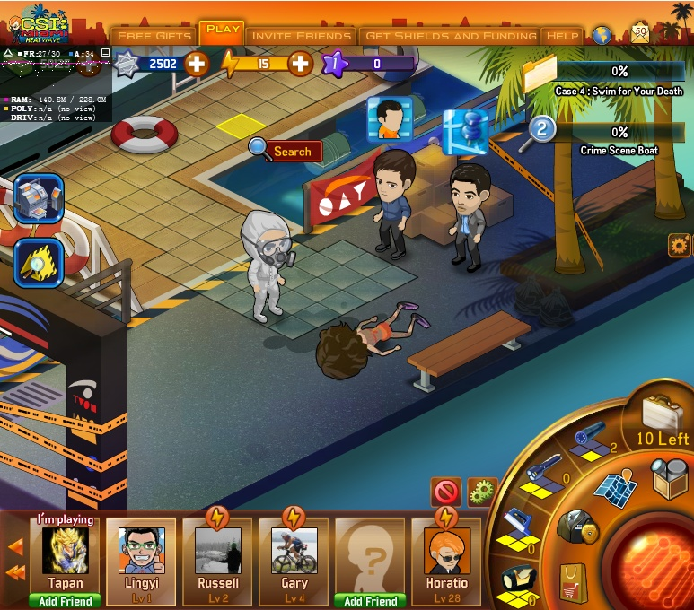

UI
!

Slide 5
UI
!

Slide 6

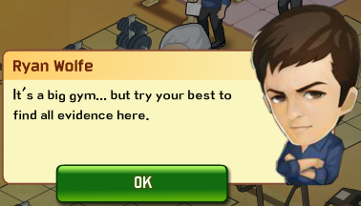
UI click to see dialogue box
Horatio
Ian said his mom never was sick a day in her life. She was in great shape.

Slide 7
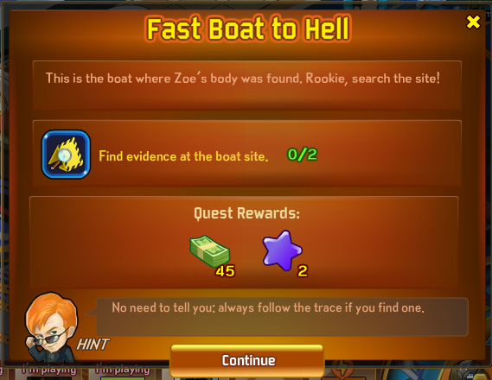

UI click continue to close the UI

Slide 8

UI quest icon added to quests list

Slide 9
Timed Rep quest
Goal:
Push player to the direction with a time limit
Source:
Automatically triggered each time the player login to the game
Reward:
Normal/Normal + Rep

Slide 10
New

Slide 11
Quest title
X
Quest description
22:33:33:33
Sub task 1 0/10
5 to pass
Sub task 2 0/10
5 to pass
Sub task 3 0/10
5 to pass
Sub task 4 0/10
5 to pass
Rewards:
Quest rewards
Quest hints
Continue

Slide 12
22:33:33:33

Slide 13
Quest title
X
Quest description
Expired !
Sub task 1 0/10
5 to pass
Sub task 2 0/10
5 to pass
Sub task 3 0/10
5 to pass
Sub task 4 0/10
5 to pass
Rewards:
Quest rewards
Quest hints
Complete: 5

Slide 14
Timed Rep quest rule
Show 2 timed quests after tutorial
1 Weekly timed quests (Provide by Chase & Eric)
1 Short term time quests (Provide by dev team)
Keep regenerating until player have 1 of such quests available in hand
Randomly picked from quest pool matching the case ID
Recycle out of time quest
Outdated short term quest will disappeared after 8h since expired
Outdated weekly quest will disappeared after 24h since expired

Slide 15
Weekly timed quest
Initial & expire time
Initial at Monday 00:00
Expire at Sunday 24:00
E.g. Player will have 3 days left if they login the game on Thursday

Slide 16
Quest type
Normal quest
Case
Retention
Monetization
Empathy quest
All have rep tag
Timed quest
Quest Icon Frame
Quest Icon
Rep tag
22:33:33:33
Time left

Slide 17
Mockups
Plan A: 1 time units + “left”
2 day left
2 hours left
3 mins left
3 secs left
Plan B: 2 time units + “left”
2d 25h left
2h 25m left
2m 25s left
Plan C: 2 time units
2d 25h
2h 25m
2m 25s
Plan D: 3 time units
2d 25h 35m
2h 25m 35s

Slide 18
Quest Giver
Horatio
Frank
Ryan
Eric
Natalia
Walter
Tom Loman
Suspects
Check time with artists and programers

